Slide 1

Webhooks & APIs

Slide 2
What is a Webhook?
A Webhook allows applications to communicate with each other
Allows event-based data transfer from one application to another in real time

Slide 3

Example
You have an e-commerce website
You want to give users a discount coupon worth 500 points when they sign up or fill a survey on your partner website

Slide 4
Webhooks
What webhook can does is to notify your e-commerce application whenever an account is created on the partner website
Passing the data from Application A to Application B over the web based on some event
The receiving application is responsible for handling the data it receives as per the business rules

Slide 5
Webhook
The exchange of information occurs through a “Webhook URL”
This Webhook URL is provided by the receiving application
Think of this URL as a contact number shared by the receiver
The data is sent is usually in JSON or XML format and is referred to as Payload

Slide 6
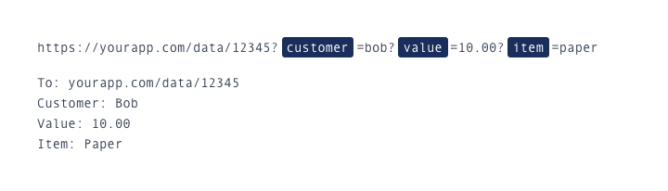
Example
A Webhook URL can look like this:

Slide 7
More Examples
You can use a webhook to connect a payment gateway to your customer service software so that a user gets an email whenever a payment is successfully received
Sending data based on an event to some other applications for analytics

Slide 8
Webhook vs API
Both Webhooks and Application Programming Interfaces (APIs) are used by applications to communicate with each other
But they differ in the way data is received

Slide 9
Webhook vs API
Application periodically makes a request to API server to check for data i.e. to see when it can “pull” the data from sender
In contrast, a Webhook allows sender to “push” the data as soon as the event occurs
Webhook can be considered as a “Reverse API”

Slide 10
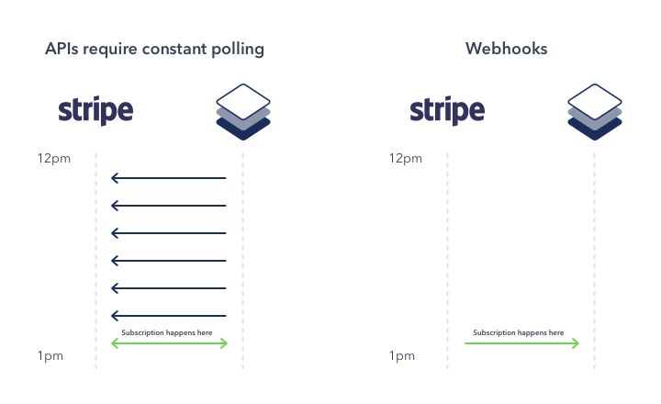
Example

Slide 11
Why use APIs then?
Not every application support Webhooks yet
Webhooks only notify the receiving application about an event. If any actions are to be taken then an API is required

